Slide 1
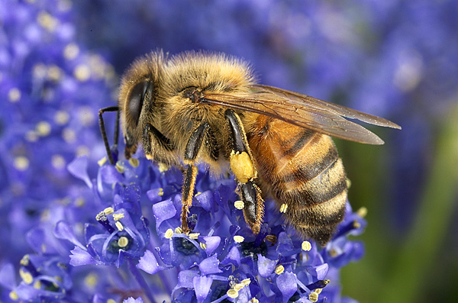
BEE BASICS – Bees, Hive, Equipment, Apiary TORY
Dewey M. Caron
OSU Affiliate Faculty

Slide 2
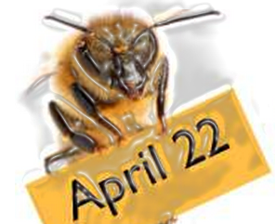
Earth Day – Happy 45th April 22nd

Slide 3
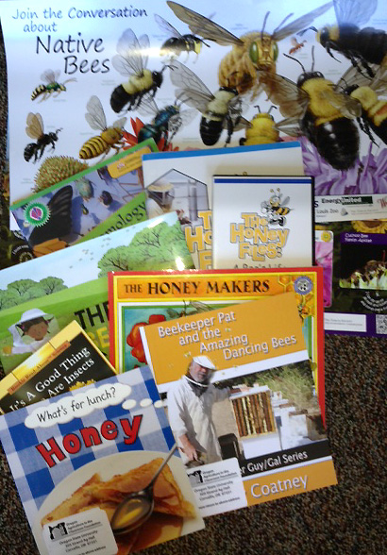
Ag in Classroom

Slide 4
Spring in a bee colony….
What do we need for this to be our NEXT Spring?

Slide 5
Bee Basics
Bees
Bee hive
Location for hives i.e Apiary
Personal protective equipment
Tools to work bees
Courage and fortitude
Some knowledge

Slide 6
We need ______ Bees!!
Apis mellifera mellifera
German bee
A. m. carnica
Carniolan bee
m. ligustica
Italian bee
m. caucasica
Caucasian bee
www.graphicmaps.com
Better -- selected/local stock!!
Notes:
Temperate Mediterranean and NW European bee races are the principal honey bees of commerce today. Both subspecies name (2nd mellifera of Apis mellifera mellifera) and common geographical name supplied. Each of these 4 covered in following 4 frames. NOTE: Races from rest of Europe and Mediterranean not on map nor individually covered.

Slide 7
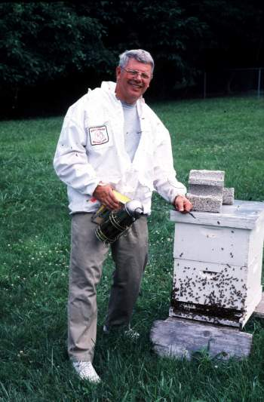
So… How do we get ‘em?
1. They find us
Swarms – bait hives
2. We transfer them
Beetrees/sides building
3. We buy them
Packages/nucs colonies

Slide 8
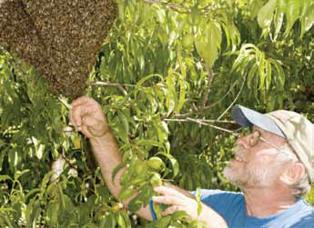
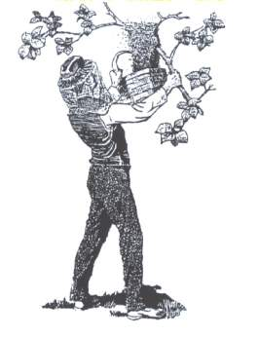
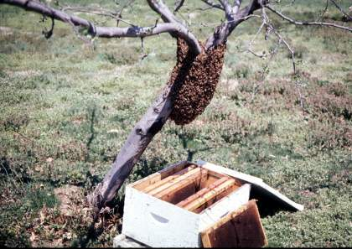
They find us -Capture a swarm
Capture a swarm (FREE BEES)
Notes:
Capture a swarm means ‘Free’ bees sometimes with a real lesson. If convenient as on tree trunk left or low hanging tree branch as in USDA drawing at right it works well and capture can be rapid and successful. With varroa mites negatively affecting colonies, there are fewer swarms available.

Slide 9
Swarms……

Slide 10
& Beekeepers to capture them….

Slide 11
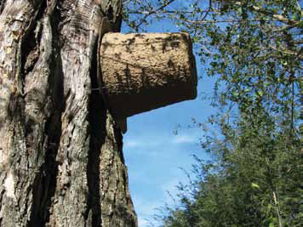
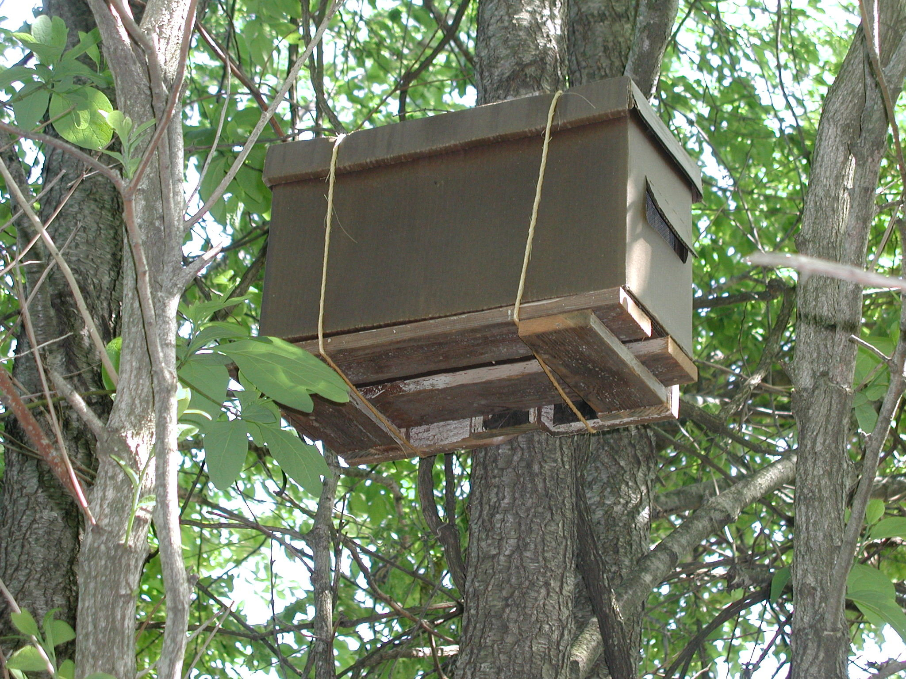
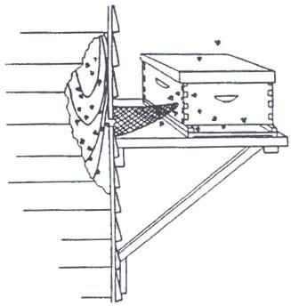
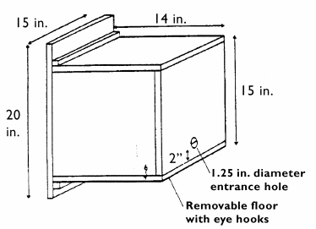
Bait a swarm
Attract a swarm
(w/ pheromone
bait box)
Notes:
Use a bait hive – have bees come to you. See Box 23 for details on use of Bait hives to attract a swarm looking for home. Figure 11-17 top shows a paper garden plant cone positioned about 10 feet exposed on tree trunk. Old equipment (with bee smell, old piece of comb or baited with nasanov pheromone) can likewise be positioned to capture a swam. You can construct bait boxes similar to this Cornell design (Figure 11-18 below) baited with piece of beeswax or pheromone lure to attract bee swarms to come to you rather than reverse. The bees need to be transferred to a regular bee hive as soon after as inhabited as possible for best results. Boxes work better at some locations than others.

Slide 12
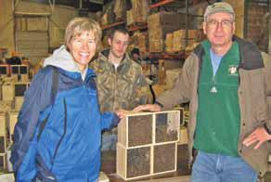
Buy packages
Notes:
Figure 11-25 new beekeepers ready to take home their 2 new 3-lb packages of bees (from bee supply dealer) after having purchased, assembled and prepared 2 hives and prepared their apiary site prior to package distribution date. If all goes as planned, the bees will be in their new hives tonight and ready to go to work for their keepers.

Slide 13
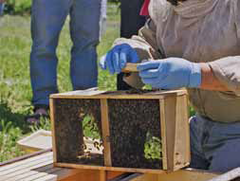
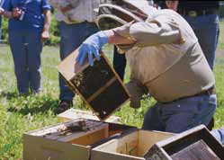
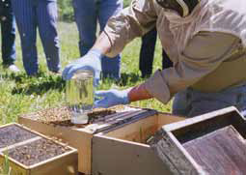
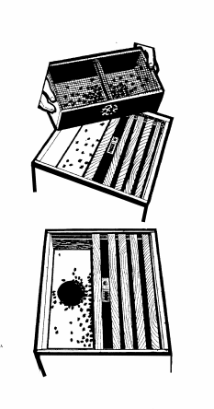
Installing Package bees
2
1
3
4
Notes:
Installing package bees – by far the “easiest” way to begin a colony of bees. 1. Figure 11-9. Checking newly arrived package to be sure queen is alive, 2. Figure 11-10. Shaking bees from package into hive body (frames of middle removed to provide room) and 3. Figure 11-11. Adding jar of sugar water before placing empty box (immediately to left of hive with bees) around the feeder jar and closing the top. 4. B&W drawing – an option to shaking bees into hive (top drawing) is to place entire shipping package, after removing shipping lid, into the hive body (bottom drawing). This alternative method carries risk that bees do not leave the shipping cage (and begin building parallel combs in the shipping package). One advantage of package bees is you know (within week or so) when the bees will arrive – and unlike the fellow in Power Point 7 you can be “ready with your hive body assembled, frames assembled with foundation and you familiar with your equipment – NOTE: in figures 11-9 to 11, beekeeper is wearing [blue] latex gloves – helps avoid stings (and keeps hands free of propolis when inspecting an established hive).

Slide 14
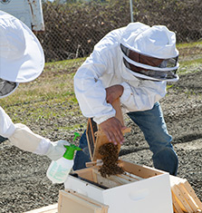
The Best Way to start?

Slide 15
Purchase a nuc

Slide 16
A nuc tale….
Overheard at the Bee Supply Store…
Mary and Dorothy are waiting to check out.
Dorothy says --
“Let me show you this new 5-frame nuc I just got”
Mary responds “what did you get the nuc for?”
Dorothy answers “I got it for my husband.”
WOW exclaimed Mary “That’s a great trade!”

Slide 17
Bee Basics
Bees
Bee hive
Location for hives i.e Apiary
Personal protective equipment
Tools to work bees
Courage and fortitude

Slide 18
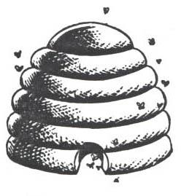
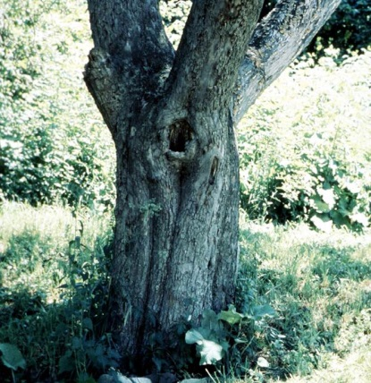
Bee Homes
Skep
Clay Pot
Log Gum
Earliest
Bee Hives
Bee tree
Skep icon
Notes:
Early bee hives were made of readily available materials. The Egyptians used pottery or pipe hives of clay. Further north beekeepers were initially hunters of hives in forest trees and adapted to keep bees in tree hollows, eventually isolating the bee nests in appropriate hollows - termed gums - or to move the colonies into simple wooden boxes (box hives). Where trees were less common, reeds or straw was fashioned into a bee domicile – termed a skep. Chapter 6 has more details on bee hives. Figures of early hives & a SKEP – an icon of bee hive (and still used in parts of the world today). See Crane (1999) and Kritsky (2010) for more information on beekeeping history and the hives humans have used to keep them in.

Slide 19
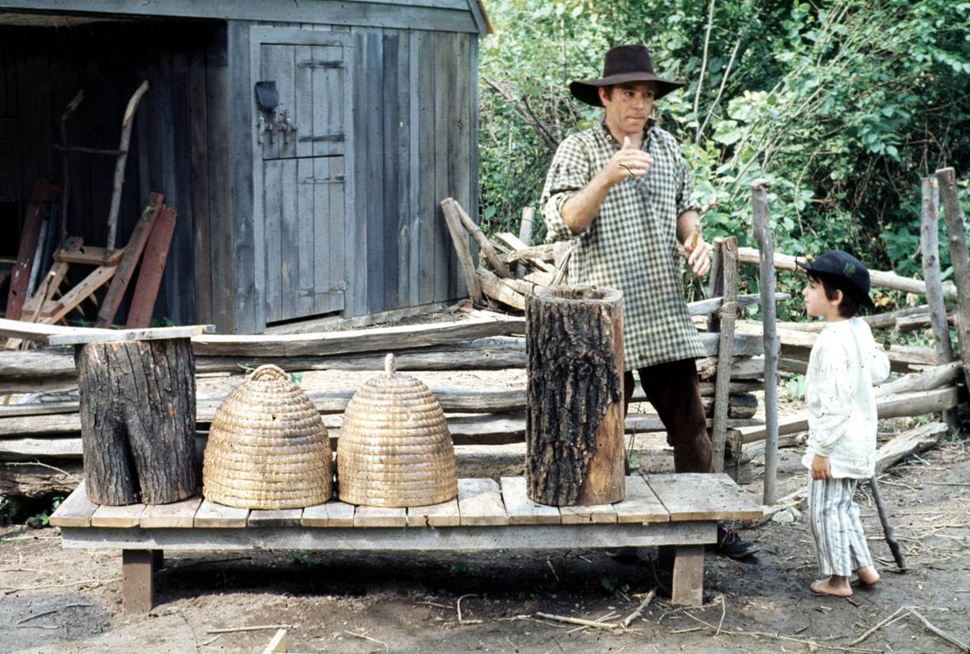
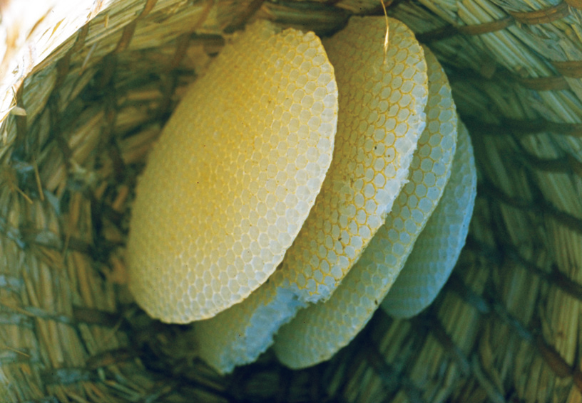
Beekeeping with Gums/Skeps
R. Williamson
Parallel beeswax combs
in wicker skep
Notes:
Straw wicker skep on left is on permanent display at OR State Univ apiary. Newly drawn beeswax parallel comb (4 total) in a straw skep (turned upside down). Figure 1-11 OSU apiary. Figure 1-12 of 4 parallel beeswax combs in skep by R. Williamson.

Slide 20
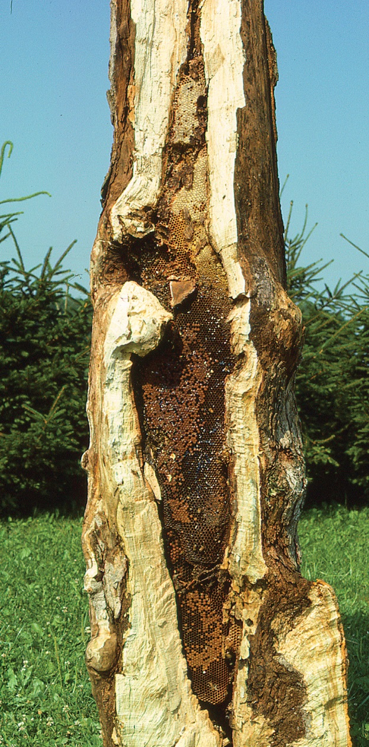
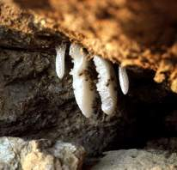
The Natural Nest
sheltered, darkened cavity
small, defensible entrance
size ~ 40 l (in European bee)
Construct parallel comb
Separate brood from food
Tom Seeley
Photo
Notes:
The natural bee nest is in a tree hollow (right photo Figure 6-3 Tom Seeley Photo) or other sheltered cavity such as under this rock overhang in Arizona (photo left Figure 6-5) or as shown elsewhere in this Chapter. Bees prefer darkened sites (wax glands function better under such conditions) and smaller openings they can defend. The European bee races select cavities of about 40 liters (size of one Langstroth standard hive body) while Africanized bees prefer cavities ½ that size. Other sizes will be utilized, especially if shelter and entrance size are suitable, when an “ideal” cavity can not be found. Once located, the bees build parallel comb and organize the comb cells into a brood area and a food storage (honey) area.

Slide 21
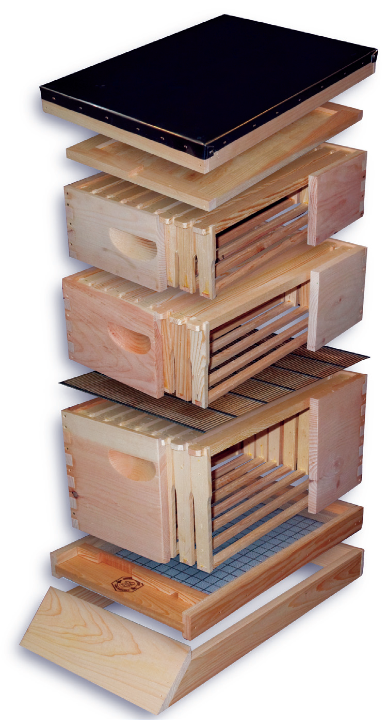
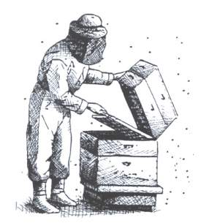
The
Langstroth Hive
Brushy Mountain Bee Supply
BASIC CONCEPT– separation of brood & food
Notes:
Modern Langstroth hive – constructed bee hive design most widely utilized world wide (although probably more rustic bee hives than movable frame hives in use worldwide). The box size varies – often boxes for brood are deeper and the boxes for honey storage (supers) are not as deep – in diagram the beekeeper is using a queen excluder to insure the queen (and brood) stays below the supers on top. Figure 6-17 diagram of modern hive courtesy of Brushy Mountain Bee Supply.

Slide 22
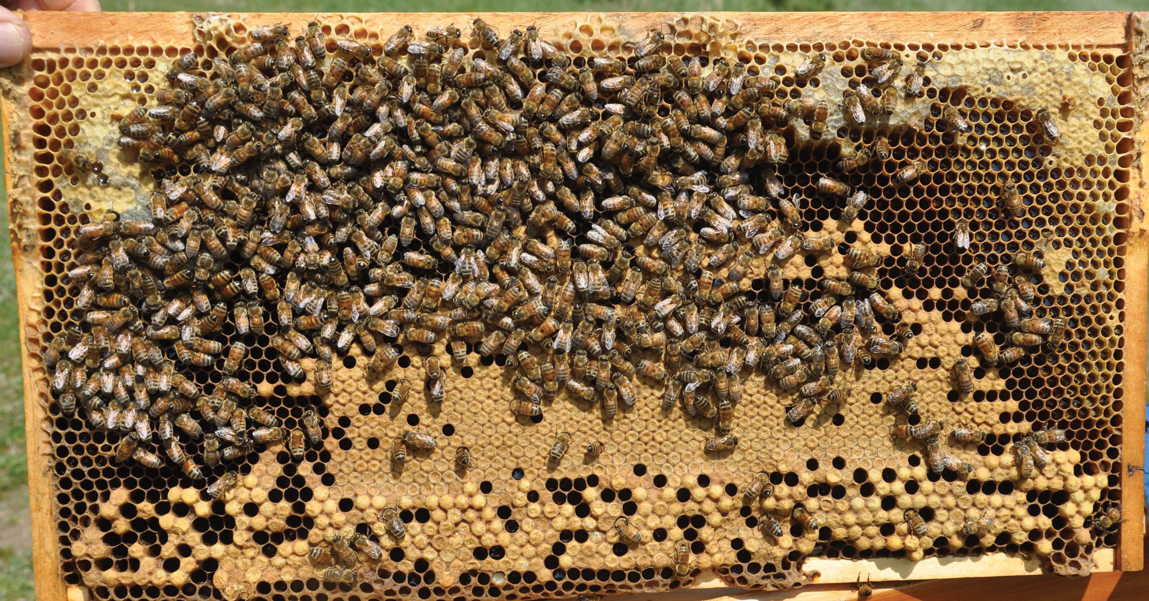
Basic comb organization
Capped honey cells
L. Connor Photo
Capped worker cells capped drone cells
Notes:
Figure 6-22 another example of a frame showing the basic organizational pattern of bees – brood central, stored pollen (bee bread to the outside of the brood) and then stored honey to the top corners and in frames (boxes=supers) above the brood area (as explained for Box 11). L. Connor Photo.

Slide 23
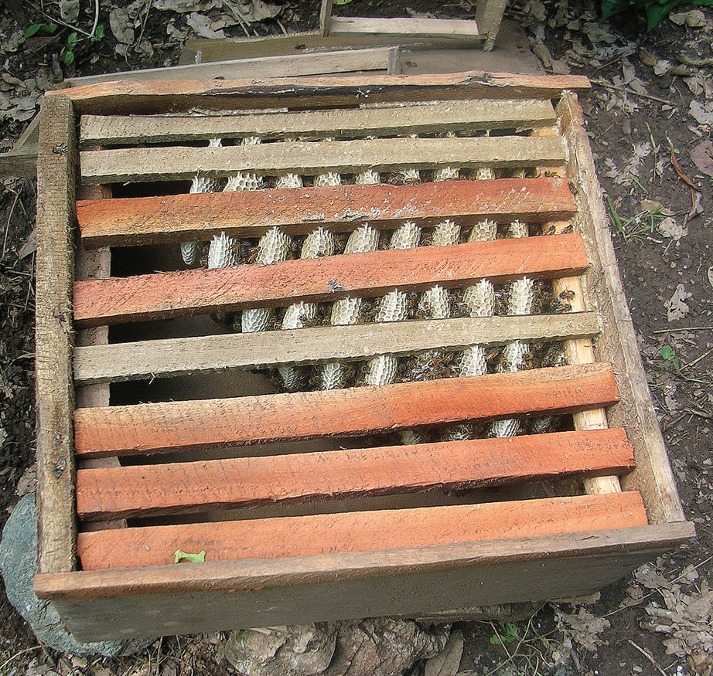
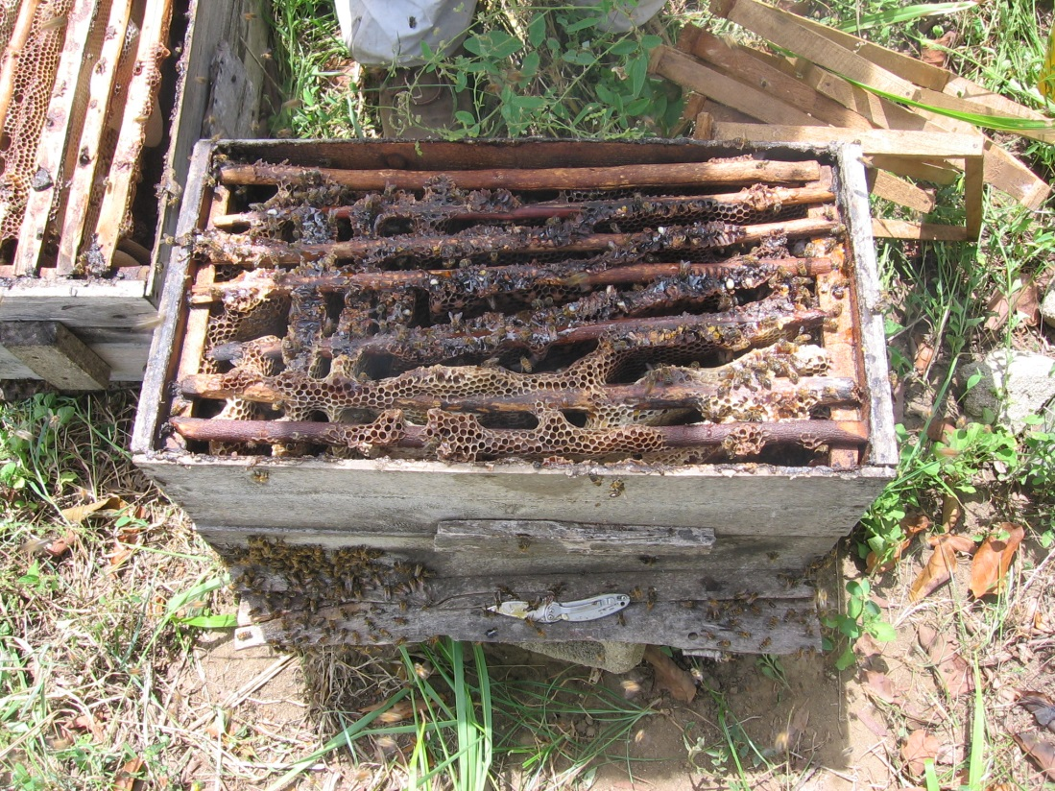
Parallel but not removable
Notes:
The bees built their parallel comb in this beekeepers box – but they did not follow the template (left) as provided by the beekeeper. Spacing of bars on right was too large and the resulting combs are not easily removal. Hives of such fixed non-removable comb are termed rustic hives.

Slide 24
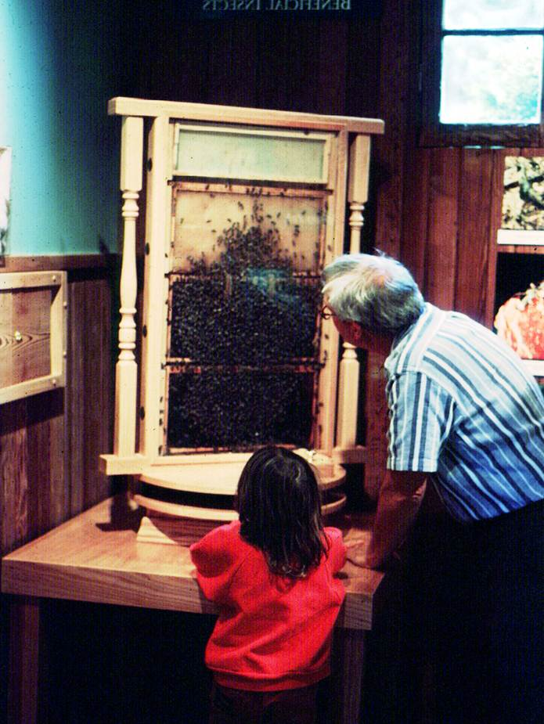
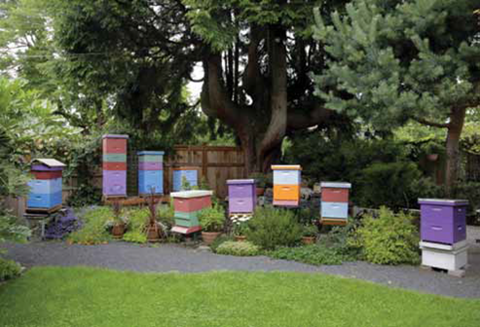
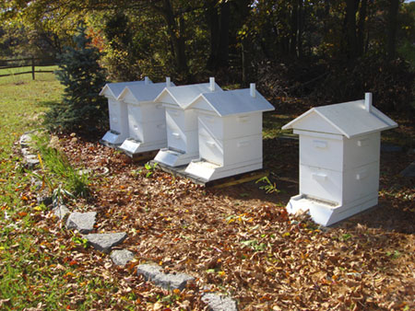
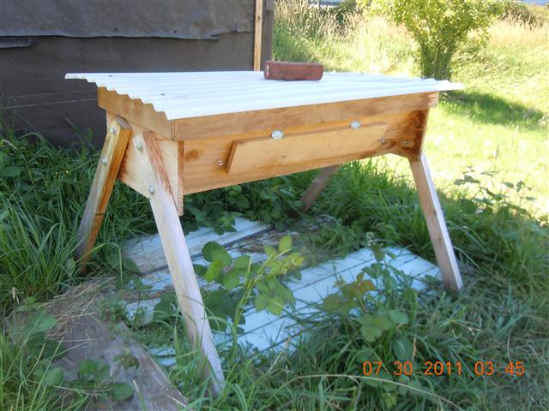
Beekeeping hives
Langstroth 8 or 10 frame
Vertical hives
Other
Warré hive
Observation
hive
Horizontal hives
Top bar hive
Long hive

Slide 25
Bee Basics
Bees
Bee hive
Location for hives i.e Apiary
Personal protective equipment
Tools to work bees
Courage and fortitude

Slide 26
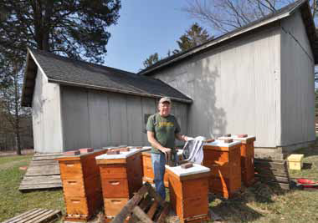
The Apiary (Location)
L Connor Photo
traditionally – out behind the barn
Out of sight – out of mind
Notes:
Traditional apiary location is in some sheltered, less exposed site in a backyard, on a farm, etc. Out behind the barn – a traditional colony location (apiary site). Figure 11-15 L. Connor photo of author shows such a site – wooden pallets are used during winter for wind deflection (and serve as hive stands)

Slide 27
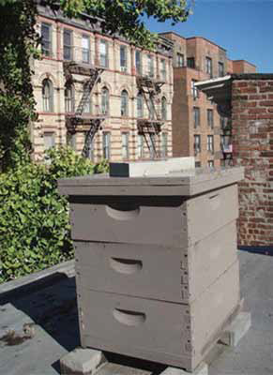
The ideal Apiary – tips for urbanites
Consider neighbors 1st
Keep gentle, manageable bees
Know bee biology
Control swarming
Keep water source nearby
Conceal or camouflage bees
Limit inspections to ideal
weather
Don’ permit robbing
add/remove supers in timely
fashion
Be an active beekeeper
Notes:
Most beekeepers are urbanites – some tips – more could be included in such a listing. Figure 11-24 rooftop apiary (single colony painted grey o blend into surroundings) in middle of city.

Slide 28
Bee Basics
Bees
Bee hive
Location for hives
Personal protective equipment
Tools to work bees
Courage and fortitude

Slide 29
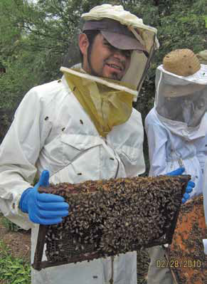
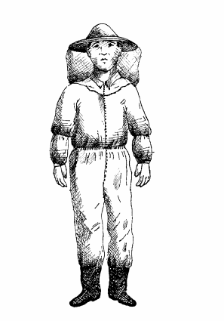
Personal equipment
bee veil
coveralls
some include veil
velcro (or elastic)
straps
gloves
boots
It is important to feel comfortable & concentrate
on inspection not to fear next sting!
Notes:
Personal protective equipment can be very expensive BUT should be adequate to insure that the beekeeper can feel comfortable in colony inspections. If he/she is worrying about being stung it will be difficult to concentrate on management/inspection tasks.

Slide 30
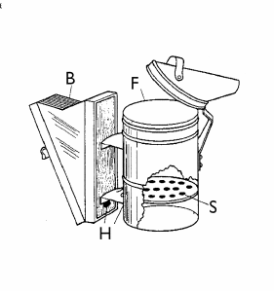
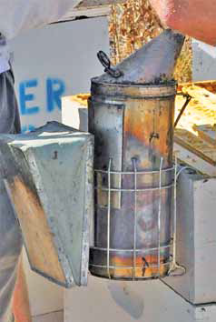
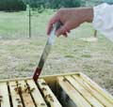
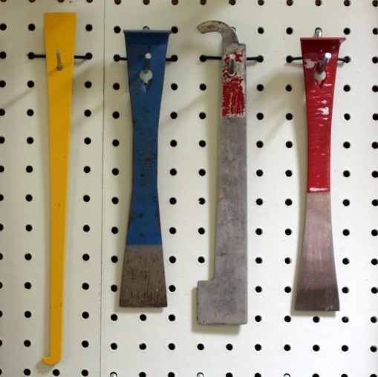
Personal equipment
bee veil, coveralls, gloves etc
smoker
hive tool (or frame lifter)
Or water/sugar
water mister
L. Connor photo
Notes:
Ancillary equipment of smoker & hive tool are key equipment tools. Smoker (Figure 11-3) is behavior modification tool (change guarding behavior) and hive tool is important to avoid jarring and eases removal of equipment both of which helps reduce chances of being stung. Costs vary. This smoker has hanger on cylinder guard to hand the smoker from side of hive for easy access. L. Connor photo.

Slide 31
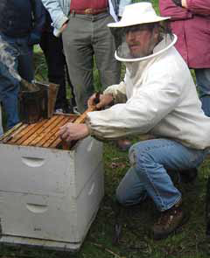
Why do these work?
Smoker a tool
Practice makes perfect
It’s the smart use – not the fuel that makes it a useful tool
Ditto hive tool
indispensable tool that (1) tends to disperse bees, driving them away from the hands (2) causes some of the bees to take flight but stimulates others to gorge on honey and (3) masks odors, which helps counter the alarm chemical
Notes:
Figure 12-3 Beekeeper with bee jacket, smoker nearby (on back corner of hive itself), hive tool in right palm. He is kneeling to ease the back stress. The smoker held in hand or close by is good bee stewardship (some models have a hook on the cylinder guard to hook the smoker on the hive itself). There is a photo essay Page 190, Figures 12-16 to 12-21 on proper lighting of smoker – for some beekeepers an especially difficult task to master.

Slide 32
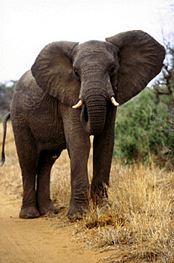
Bee Basics
Bees
Bee hive
Location for hives
Personal protective
equipment
Tools to work bees
Courage and fortitude

Slide 33
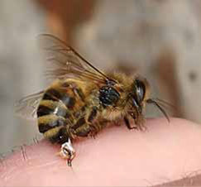
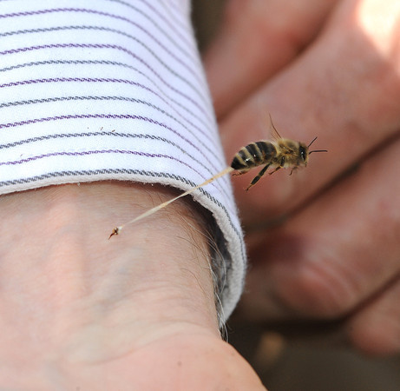
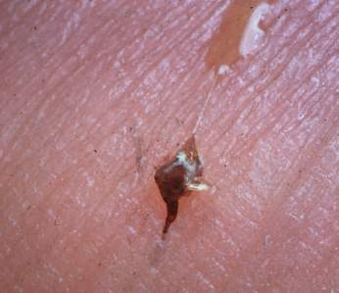
Bee stings
Sting left in victim
Note: liquid at top right is from digestive system
Notes:
Sting left in victim skin after being stung. Glands of the sting (4 different glands but sting and Koschevnikov primarily) produce iso-pentyl acetate (IPA) along with 40 other compounds. These materials have odor similar to banana oil and they attract other bees to investigate – they are the alarm pheromone.

Slide 34
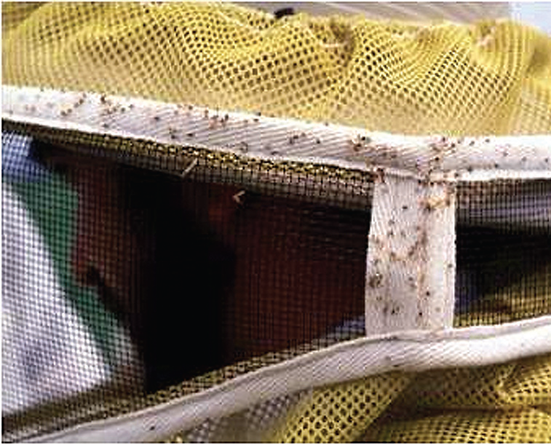
Stings= Alarm pheromone
Notes:
Figure 8-6 stings in bee veil fabric – each sting left in victim’s clothing serves to convey alarm to the colony and effectively mark the victim. Additionally see Box 15 for other modalities of honey bee/colony defense.

Slide 35
My Ass is covered when I visit the bees

Slide 36
Bee Basics
Bees
Bee hive
Location for hives
Personal protective equipment
Tools to work bees
Courage and fortitude
Some knowledge

Slide 37
Typical annual cycle
Notes:
Figure 4-28. Typical cycle for Willamette Valley of Oregon – you need to use cycle typical for beekeeping in your region. Top graph courtesy of commercial beekeeper George Hansen – generalized cycle below from Ruhl Bee Supply Portland, OR.

Slide 38
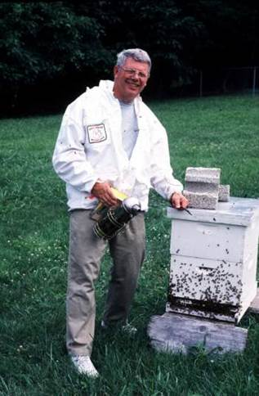
Are you in this picture?
dmcaron@udel.edu

